Slide 1


Social Buzz Case Study

Slide 2


Today's agenda
Project recap
Problem
The Analytics team
Process
Insights
Summary

Slide 3

With over 500 million monthly active users, Social Buzz has grown rapidly, necessitating scaling oversight. Accenture has begun 3 month POC focusing on these task:
An audit of their big data practice
Recommendations for a successful IPO
An analysis of their content categories that highlights the top 5 categories with the largest aggregate popularity
Project Recap

Slide 4

Problem
Over 100000 posts per day
36,500,000 pieces of content per year!
But how to capitalize on it when there is so much?
Analysis to find Social Buzz’s top 5 most popular categories of content

Slide 5



Andrew Fleming
Chief Technical Architect
The Analytics team
Marcus Rompton
Senior Principle
Insert Name
Data Analyst

Slide 6
Process
1
Data Understanding
2
Data Cleaning
3
Data Modelling
4
Data Analysis
5
Uncover Insights

Slide 7

Insights
16
5691
MAY
Unique
Categories
Reactions to “Animal” posts
Month with Most Posts

Slide 8
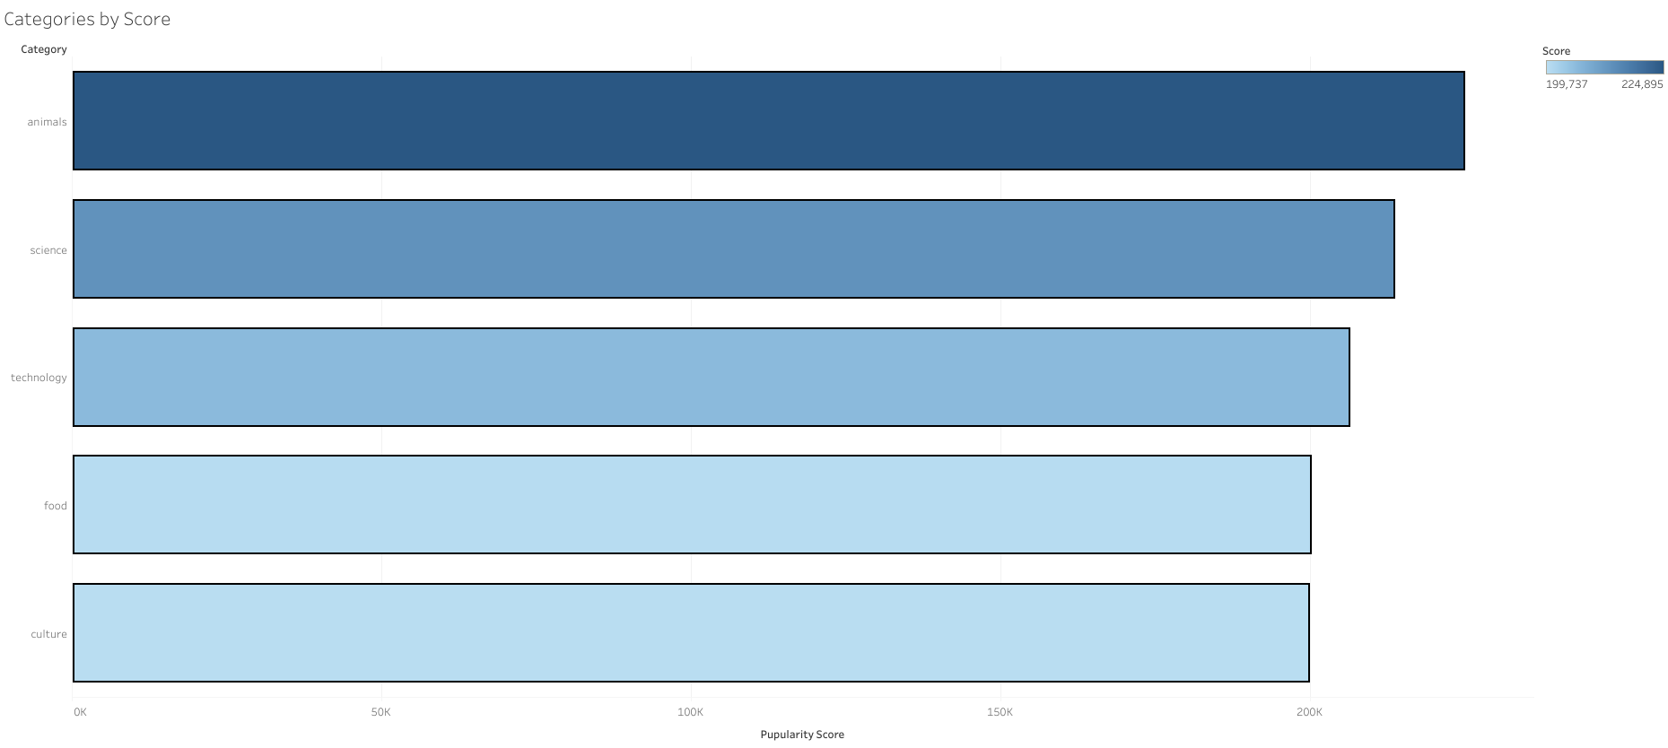

Slide 9
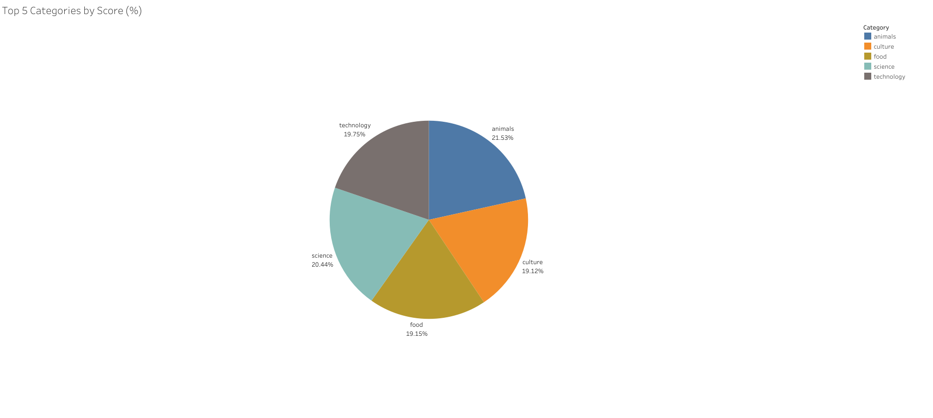

Slide 10

ANALYSIS
Animals and science are the two most popular categories of content, showing that people enjoy “real-life” and “factual” content the most
INSIGHT
Innovation and discovery seems like a them that we could explore as science and technology category is in top 5 categories
Summary

Slide 11
Thank you!
ANY QUESTIONS?

